Slide 1
Procedural Map Generation Techniques
Presented by Herbert Wolverson Roguelike Celebration 2020

Slide 2
Who is Herbert Wolverson?
Author of the “Rust Roguelike Tutorial”
Author of upcoming titles: Learn Rust by Making Games and Rust Brain Teasers published by The Pragmatic Bookshelf.
Author of Nox Futura and far too many words on r/roguelikedev

Slide 3
Introduction
What is Procedural Generation?
How does it fit in with hand-made content?
History of Procedural Generation (more slides)

Slide 4
PART 1 – Basic Generation Techniques

Slide 5
Simple Room-Based Generation
You’ve probably seen this in Roguelike development tutorials.
Simple algorithm:
Start with a solid map.
Randomly select a room area.
If the room is solid, carve it out and store it in the “rooms” list.
Repeat until you have enough rooms.
Iterate your rooms list, and add dog-leg corridors.

Slide 6
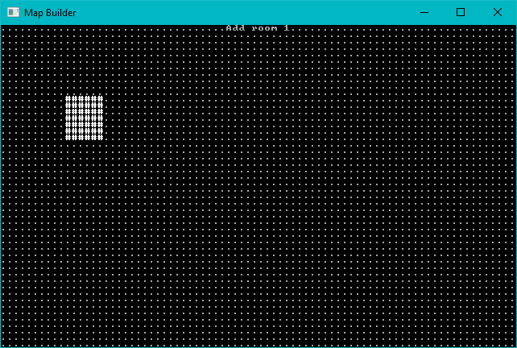
Start with a solid map, add one room at random.

Slide 7
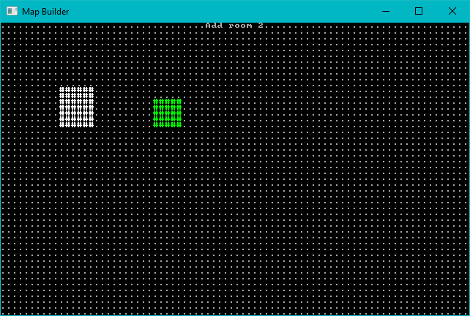
Add a second room

Slide 8
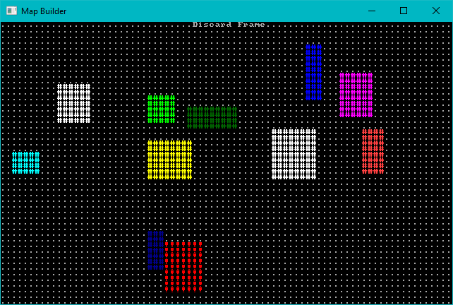
Keep Adding Rooms – Don’t Add Overlapping Ones

Slide 9
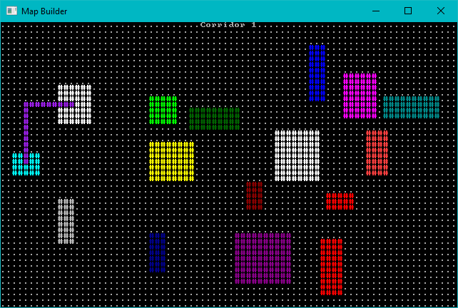
Add Corridors – Dog-leg Style

Slide 10
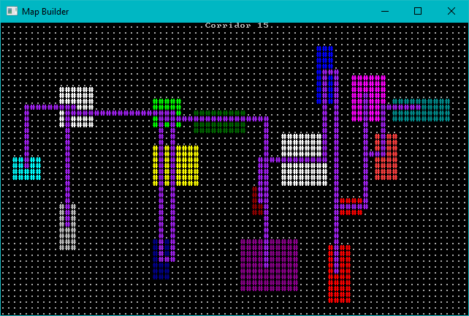
Add More Corridors Until Every Room is Connected

Slide 11
Room Algorithm - Animated

Slide 12
Sub-Divide Room-Based Generation
Nicer room generation. Nethack uses it. (In BSP form)
Divide your map into squares – and divide those squares into squares.
Each sub-square might become a room.
Sort rooms and add corridors.

Slide 13
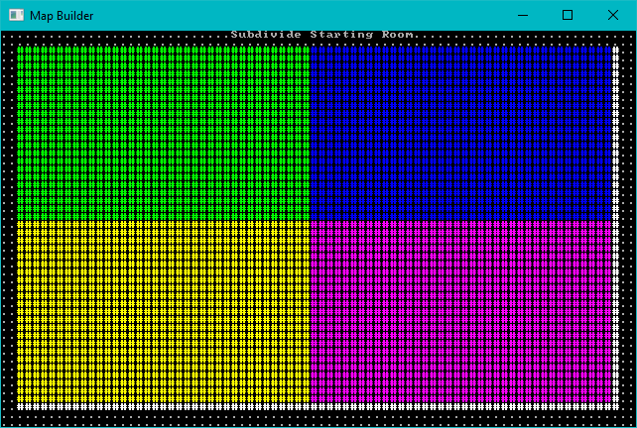
Subdivide the map

Slide 14
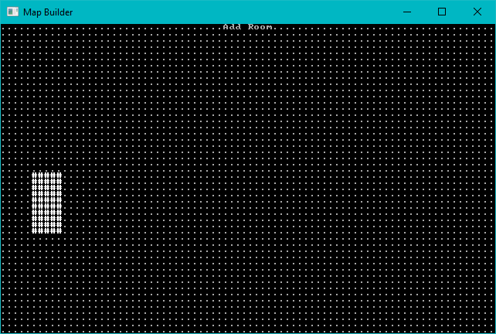
Consider each region. Either divide, or add a room.

Slide 15
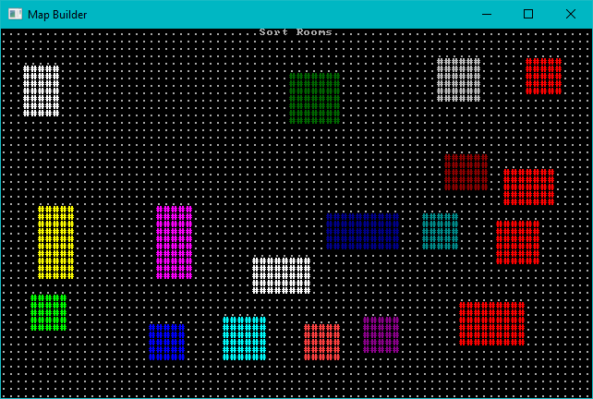
Keep Adding Rooms, Sort by X

Slide 16
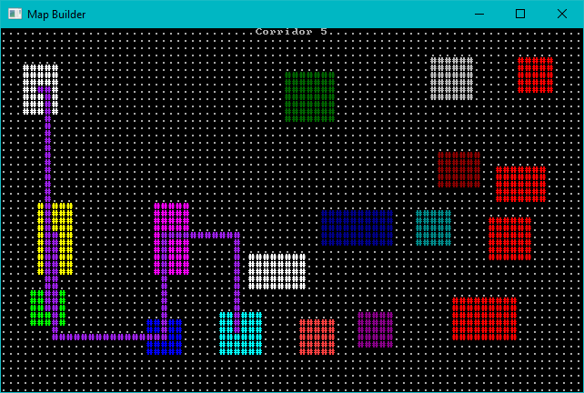
Add Corridors as Before

Slide 17
Animated Sub-Division

Slide 19
Cellular Automata

Slide 20
Conway’s Game of Life

Slide 21
Bringing Order from Chaos

Slide 22
Drunkard’s Walk

Slide 23
Drunkard’s Walk Step-by-Step

Slide 24
Diffusion Limited Aggregation

Slide 25
DLA Progression

Slide 26
Voronoi Hive Maps

Slide 27
PART 2 – Mix It Up a Bit

Slide 28
Symmetry

Slide 29
Brushes

Slide 30
Corridor Algorithms

Slide 31
Erosion

Slide 32
Doors

Slide 33
Waveform Collapse

Slide 34
PART 3 – Combining Effects

Slide 35
PART 5 – Prefabs/Vaults

Slide 36
Noise

Slide 37
Wrap-Up

Slide 38
Questions?

